Slide 1






HKBK COLLEGE OF ENGINEERING
Organizes
GEAR – UP EXPO 2024
Enhancing Transportation Safety with YOLO-Based CNN Autonomous Vehicles
Project Guide
Sarumathi S
Assistant Professor
Team Members
Mohammed Sabir
UG Student
Mohammed Suhail
UG Student
Mohammed Umarulla
UG Student
Mohammed Yousuf
UG Student

Slide 2
TABLE OF CONTENT
ABSTRACT
INTRODUCTION
OBJECTIVES
ARCHITECTURE
DESIGN ARCHITECTURE AND IMPLEMENTED MODEL
RESULT
CONCLUSION

Slide 3
ABSTRACT
Our paper titled "Enhancing Transportation Safety with YOLO-based CNN Autonomous Vehicle" aims to revolutionize autonomous driving through the integration of advanced machine learning techniques, specifically the YOLO-based Convolutional Neural Network (CNN) algorithm. By combining this algorithm with carefully selected hardware components such as the Raspberry Pi 4B with 8GB of RAM, power supply, battery, IR sensors, and motor drives, our system addresses critical objectives including object recognition and detection, lane detection, animal detection, traffic signal detection, and signboard detection. Through meticulous training and optimization of the YOLO-based CNN algorithm with diverse image datasets, our system achieves high levels of accuracy and efficiency in environmental perception and navigation. Key components such as IR sensors facilitate precise lane detection, while the algorithm's real-time object detection capabilities enable safe navigation through complex traffic scenarios. Our project represents a pioneering effort in the field of autonomous driving technology, with potential applications in various industries including automotive, logistics, and transportation. By prioritizing safety and efficiency, our autonomous vehicle system holds promise for revolutionizing transportation systems and improving road safety worldwide.

Slide 4
INTRODUCTION
In the realm of autonomous vehicles, our project titled 'Enhancing Transportation Safety with YOLO-based CNN Autonomous Vehicles' stands at the forefront of innovation. Leveraging state-of-the-art components such as ultrasonic sensors, IR sensors, and the powerful Raspberry Pi 4B GB RAM processor, alongside essential peripherals like motor drivers and servo motors, our endeavor aims to revolutionize transportation safety. With a focus on meeting key objectives including lane detection, object detection, pothole detection, and various signboard and signal detections, our model embodies a comprehensive approach towards ensuring safe and secure travel. By harnessing the capabilities of YOLO-based CNN technology, we strive to enhance situational awareness and responsiveness, ultimately paving the way towards a safer and more efficient transportation landscape.

Slide 5
OBJECTIVES
Lane Detection: Utilizing IR sensors for precise lane detection to ensure accurate navigation.
Object Detection: Implementing YOLO-based CNN for efficient detection of various objects on the road.
Animal Detection: Developing algorithms to detect and avoid animals on the roadway to enhance safety.
Traffic Signal Detection: Implementing robust algorithms for real-time detection of traffic signals to ensure compliance with traffic laws.
Traffic Signboard Detection: Utilizing image processing to recognize and interpret traffic signboards for enhanced situational awareness.
Obstacle recognition and avoidance: when the model encounters any obstacle it takes its respective action.

Slide 6
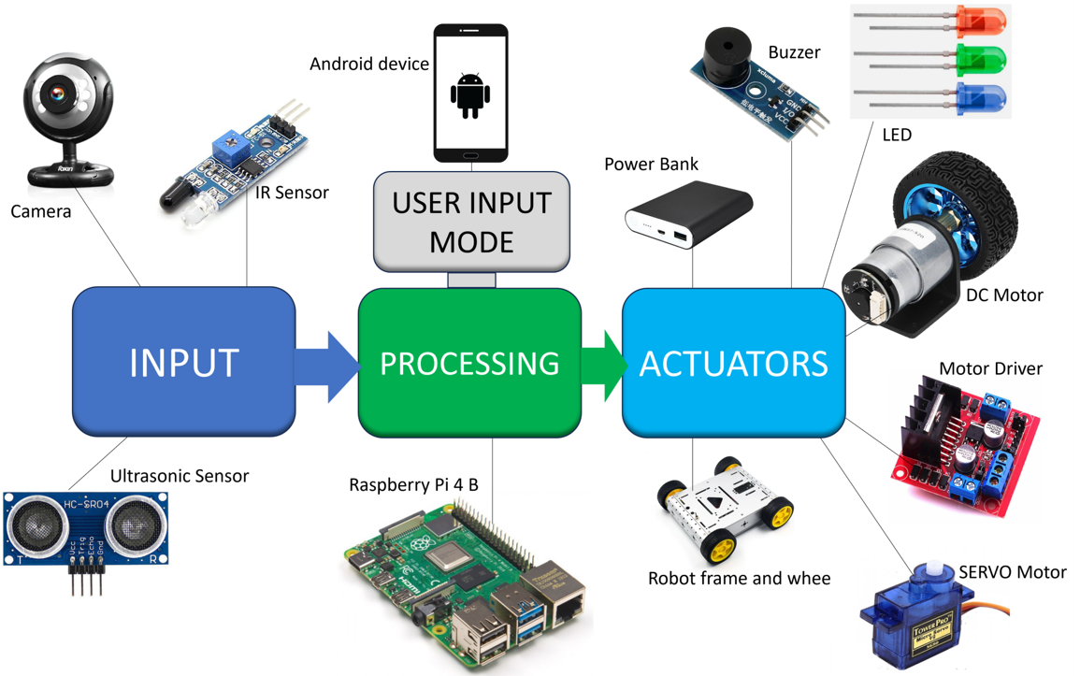
ARCHITECTURE

Slide 7
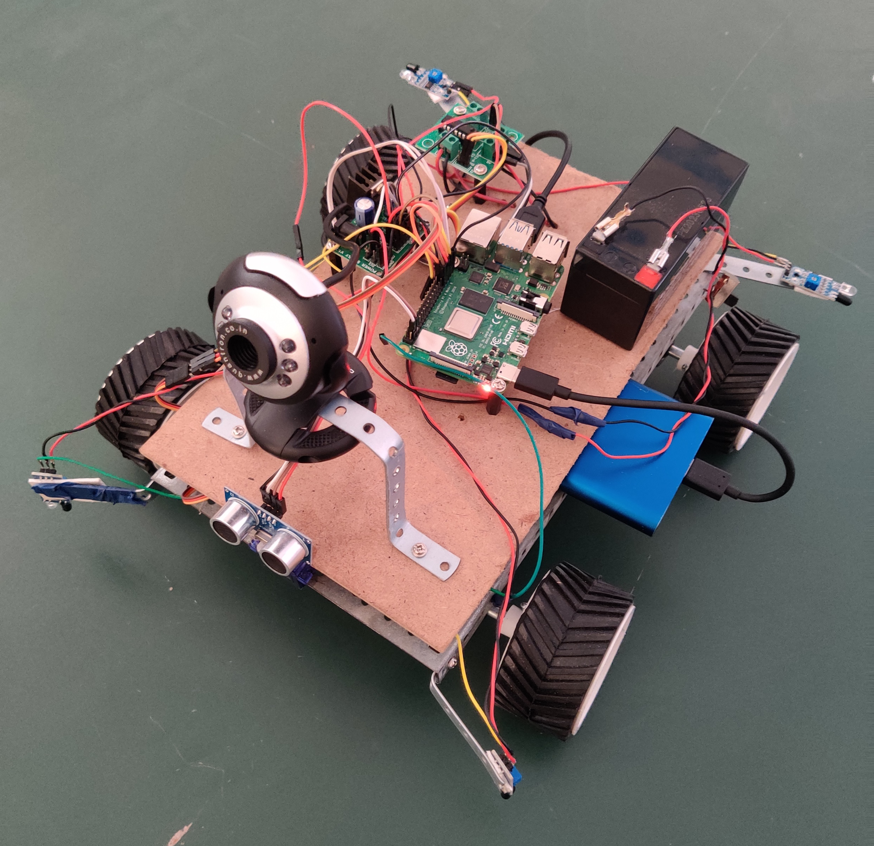
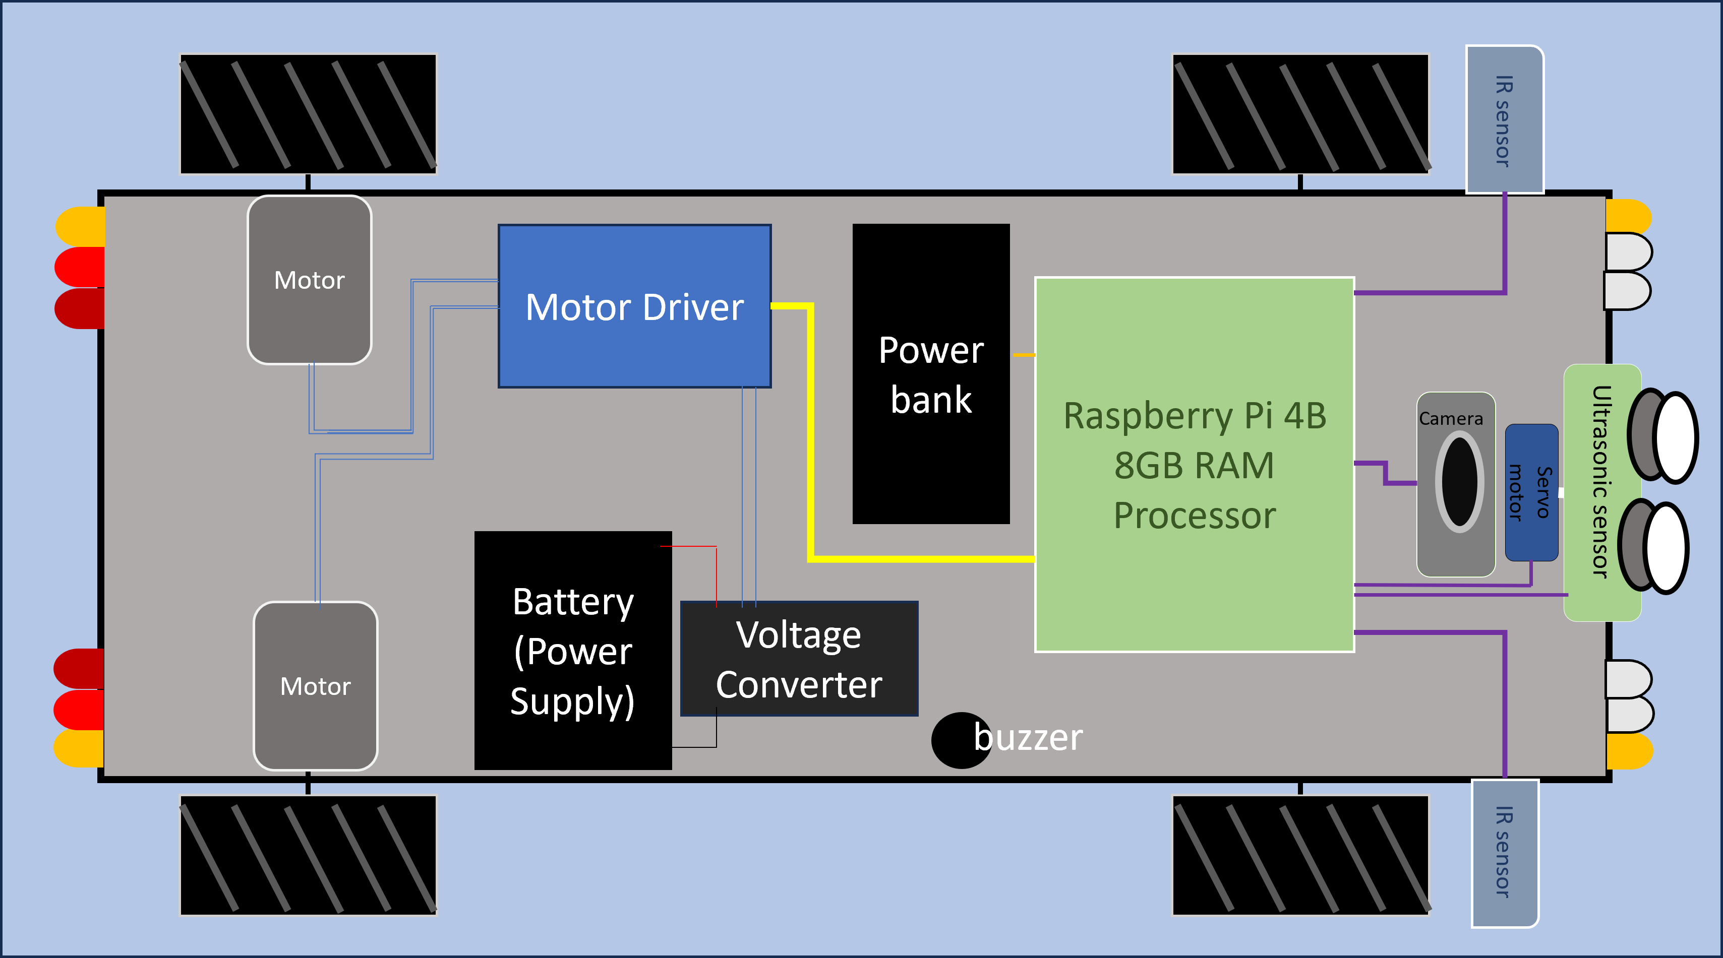
DESIGN ARCHITECTURE
IMPLEMENTED MODEL

Slide 8
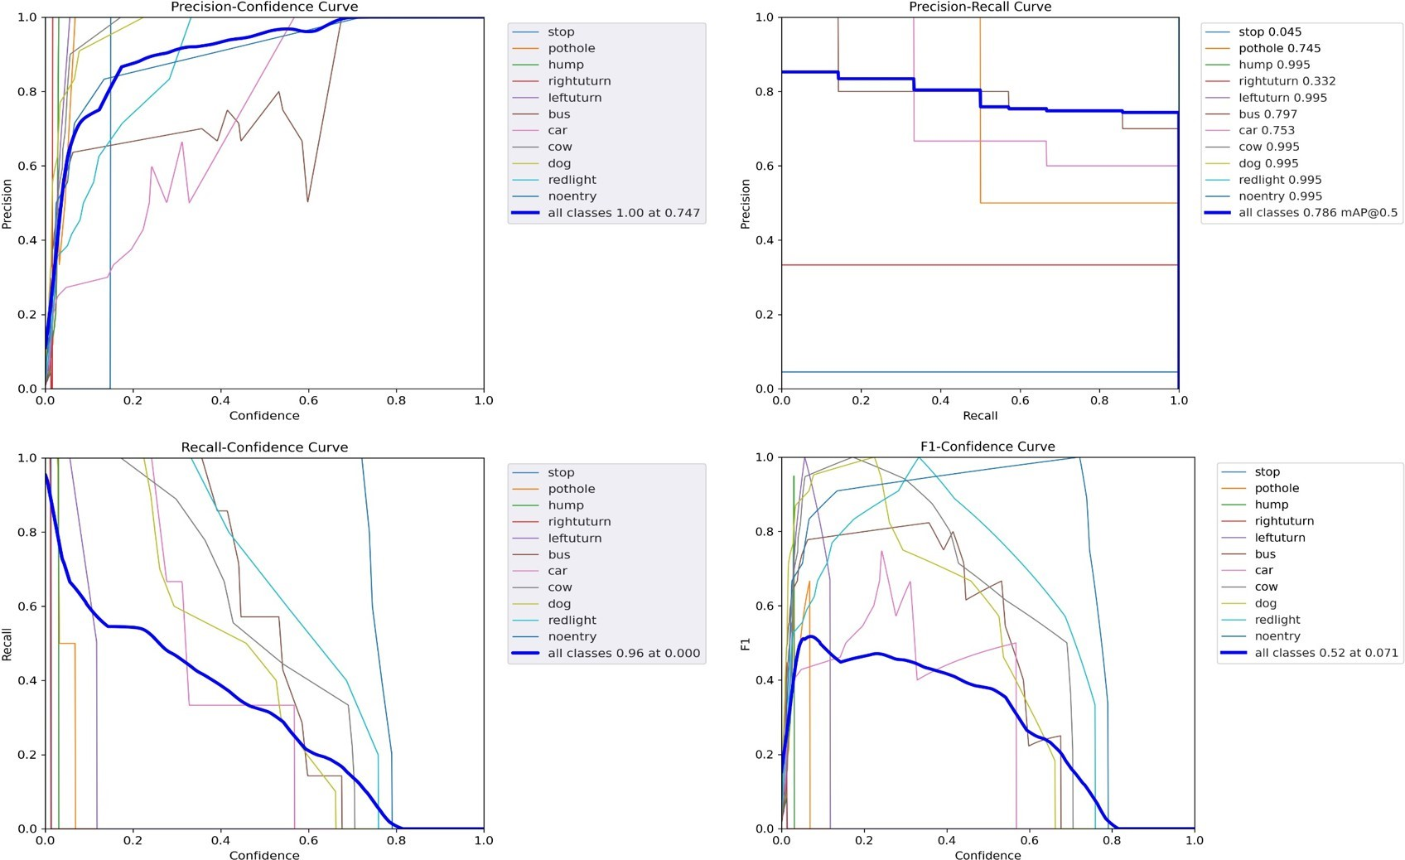
RESULT
Utilized YOLO version 5 algorithm for deep learning model training.
Achieved remarkable accuracy in object detection and classification.
Proficient in identifying vehicles, pedestrians, animals, and traffic signs.
Robust performance in recognizing and interpreting traffic signs and signals.
Deployed and tested on a 10-meter test track, simulating real-world driving conditions.
Demonstrated proficiency in lane detection, pathway identification, and obstacle avoidance.
Excellency in detecting critical safety hazards like potholes and erratic driver behavior.
Contributed to the creation of safer transportation environments.
Fig: Graph Analysis

Slide 9
CONCLUSION
In conclusion, our research, “Enhancing Transportation Safety with YOLO-based CNN Autonomous Vehicles”, introduces a pioneering methodology aimed at bolstering autonomous vehicle technologies. Quantitatively, our model achieved an impressive overall accuracy of 74-75 percent in real-time driving scenarios, demonstrating its effectiveness. Qualitatively, practical implementation on a 10-meter test track validated our system’s reliability and agility in maneuvering around obstacles. The seamless integration of sensors and components further enhances our vehicle’s performance. Our strategic roadmap ensures smooth integration into existing transportation networks, promising safer and more efficient mobility.

Slide 10
THANK YOU

